Slide 1




WELCOME TO
EDUFUSION
WELCOME TO
EDUFUSION !
In the digital age, education is no longer confined to the walls of a classroom..

Slide 2

BREIF INTRODUCTION
EduFusion is an innovative e-learning platform dedicated to revolutionizing education through personalized learning experiences using AI. Our mission is to empower learners worldwide by providing accessible, engaging, and effective educational solutions.

Slide 3

ABOUT ME
“Malek Maghraoui” a fullStack web developer (MERN stack). i’m 19 yo, studying PLSI in ISIMS, participated in 5 hackatons in total, also tried game dev, Ai dev with python (TensorFlow), worrked with models from hugging face platfrom into websites to make a functional websites based on Ai

Slide 4

PROBLEM
Despite the proliferation of e-learning platforms, many learners struggle to find personalized and engaging educational experiences tailored to their needs and preferences.
Example: Studies show that traditional online courses often suffer from low completion rates, indicating a disconnect between learners and content.

Slide 5
Key Features:
AI-based customization for personalized learning paths
Live webinars with industry experts
Peer-to-peer learning opportunities
Mobile learning app for on-the-go access
SOLUTION
EduFusion addresses the shortcomings of traditional e-learning platforms by offering a comprehensive solution that combines advanced technology with educational expertise.

Slide 6
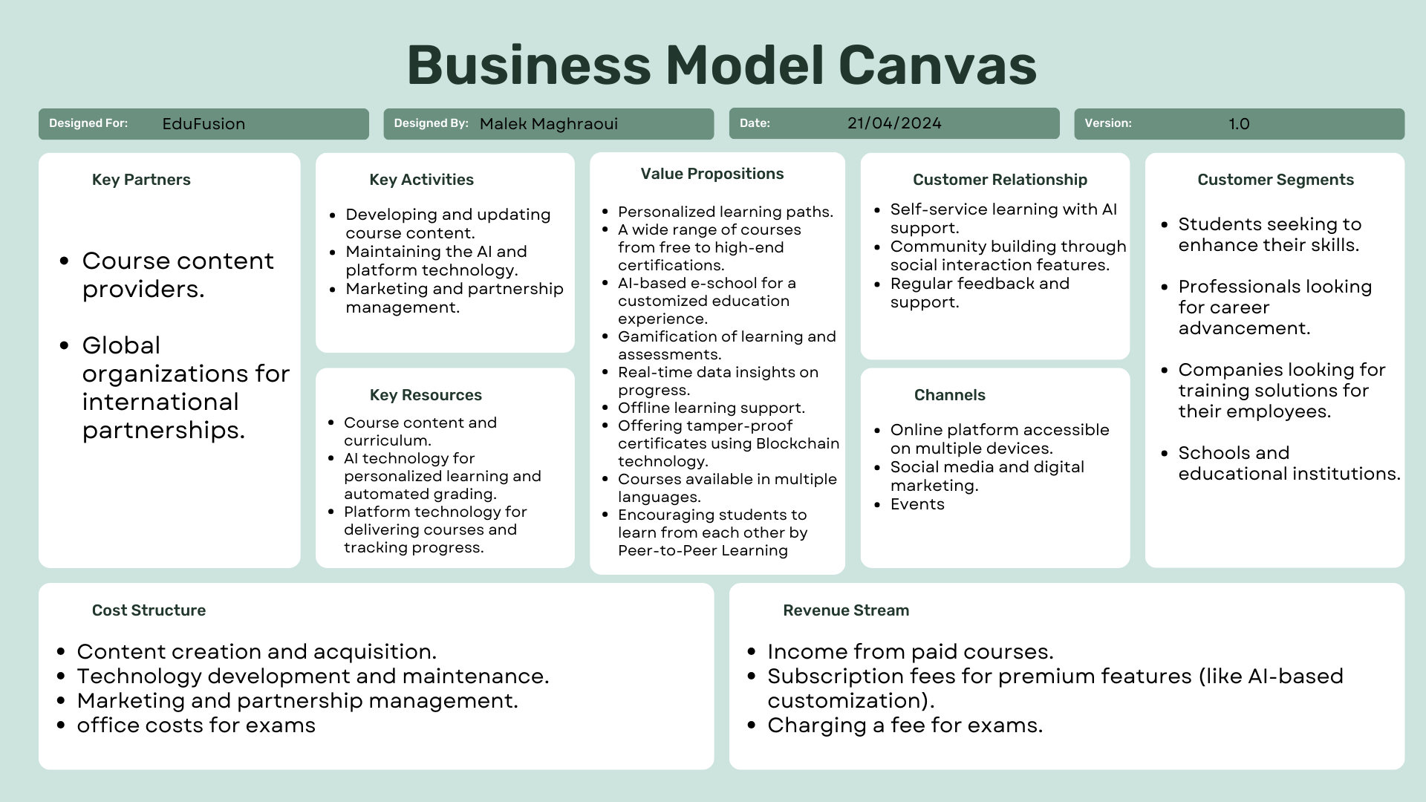

Slide 7
USER ENGAGEMENT AT EDUFUSION
EduFusion engages users through:
AI-based customization for tailored learning experiences
Live webinars offering interactive learning opportunities
Peer-to-peer learning fostering collaboration and knowledge sharing
Mobile learning app for convenient access anytime, anywhere

Slide 8
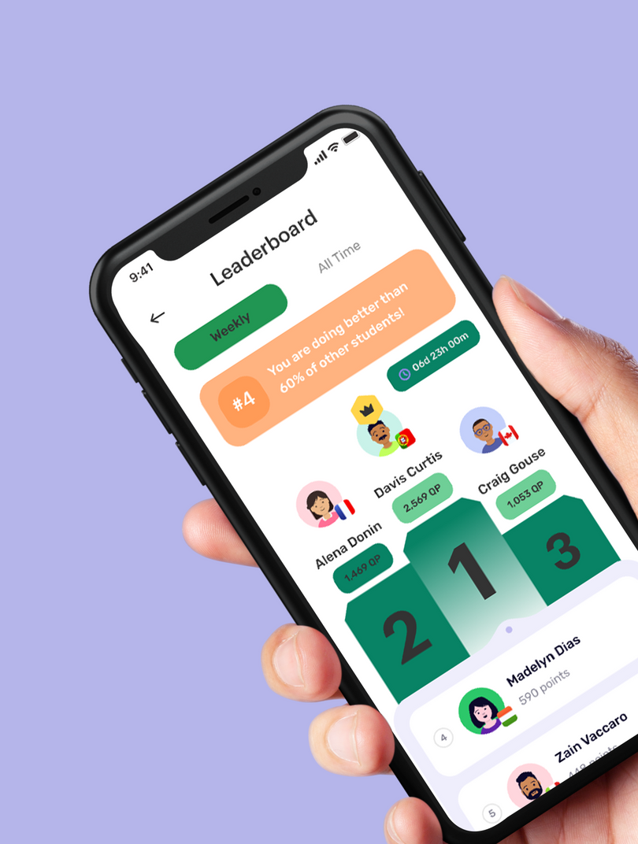
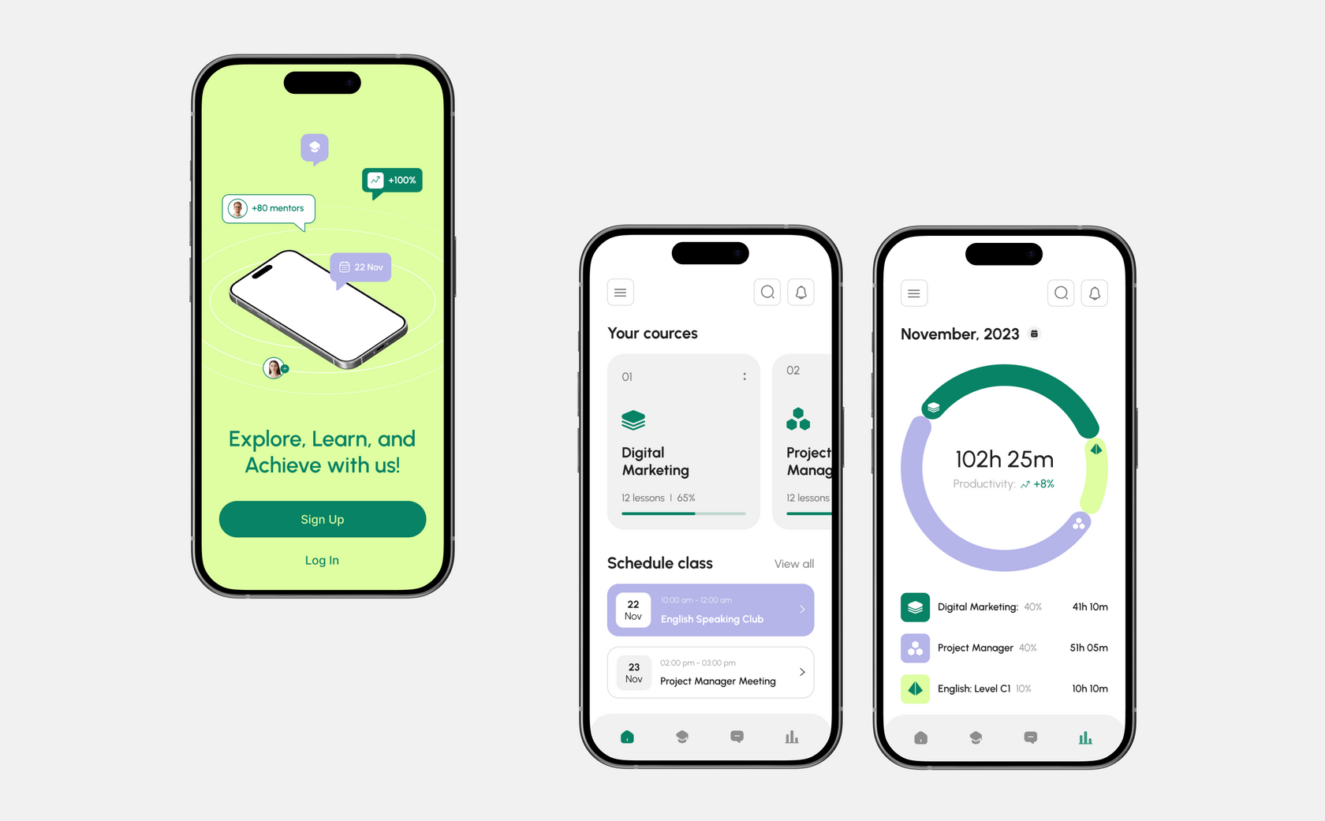
MOBILE APPLICATION PROTOTYPE

Slide 9
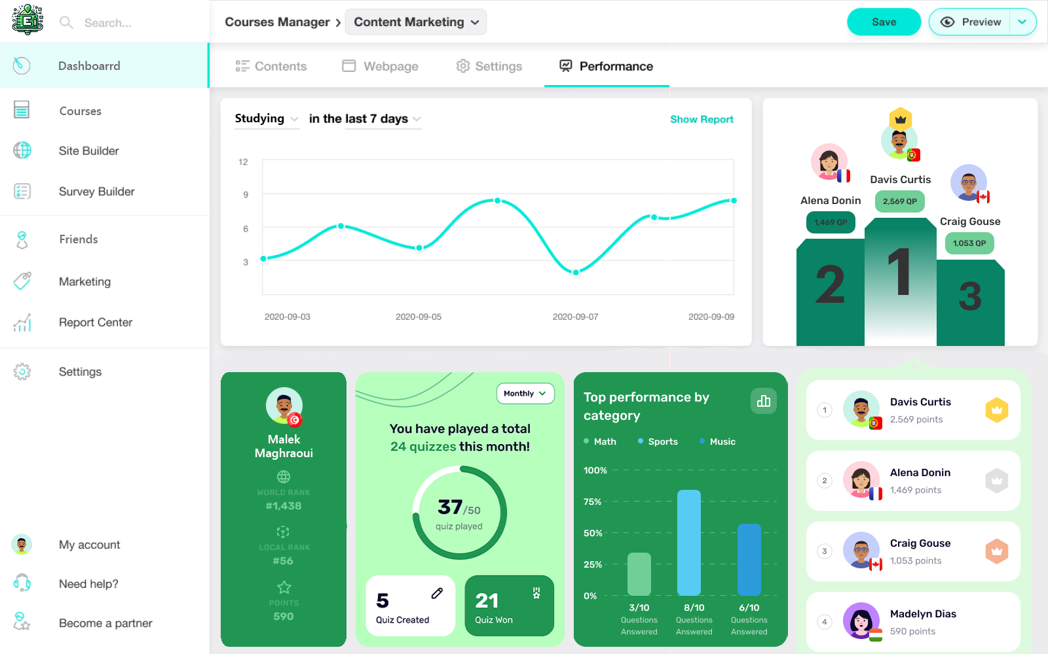
WEBSITE PROTOTYPE

Slide 10
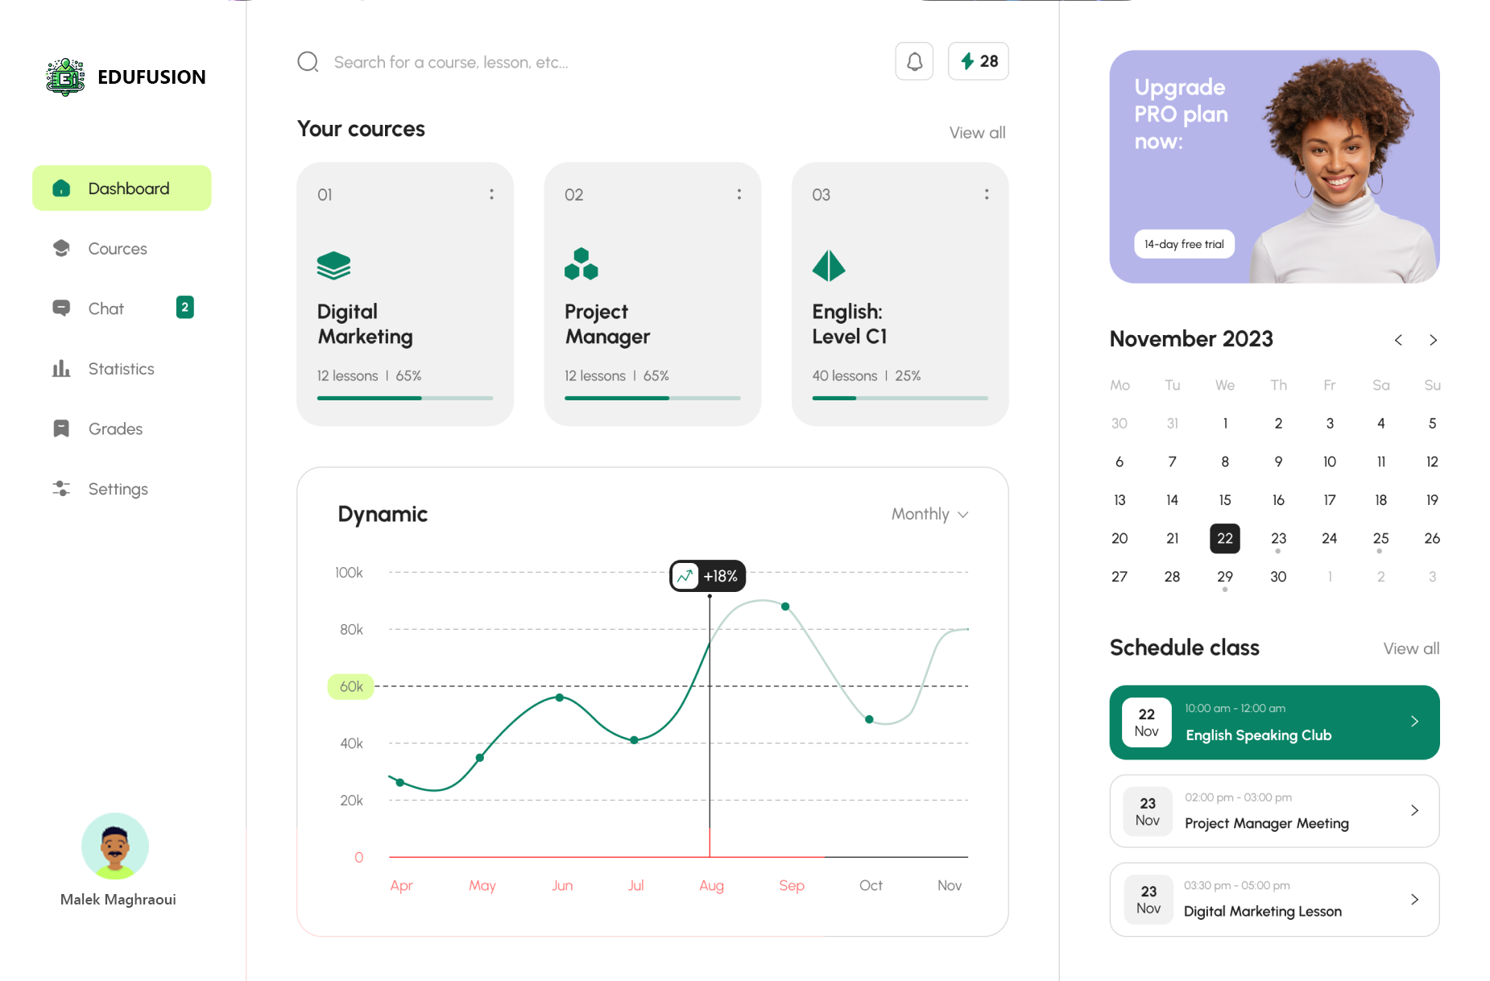
WEBSITE PROTOTYPE

Slide 11
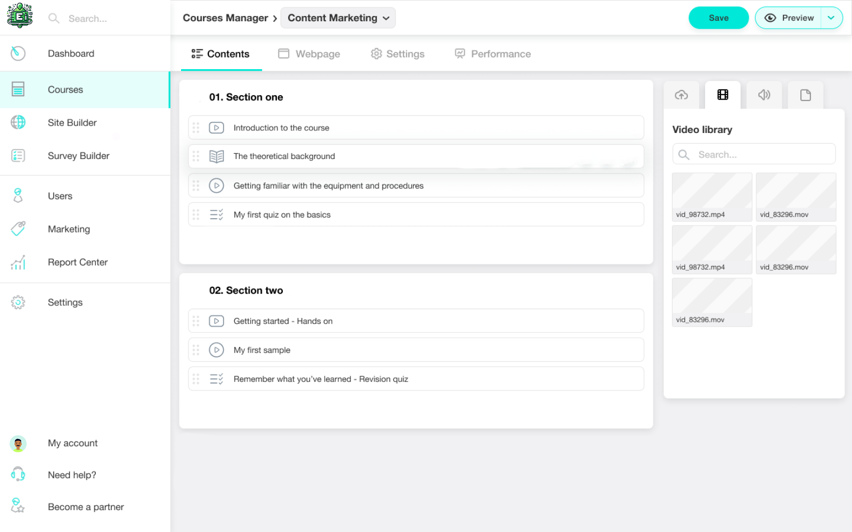
WEBSITE PROTOTYPE

Slide 12
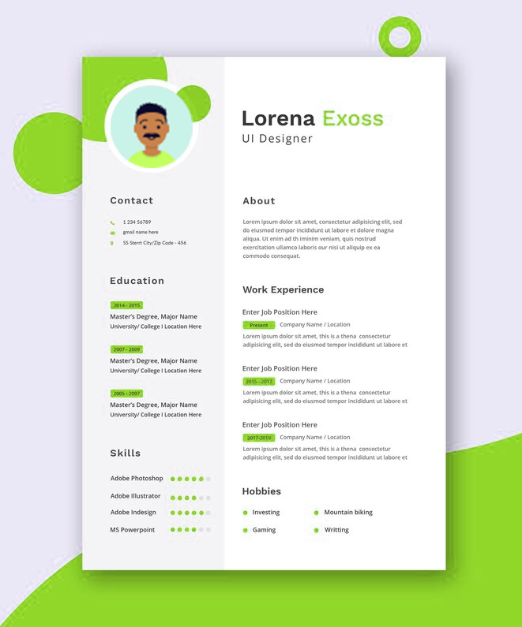
CV CREATION IS AUTOMATED NOW
EDUFUSION make it easier to builld cv and start searching for internship and make it easier for organizations to search for your profile and see the skills you have
You can easilly find jobs using this website

Slide 13
JOIN US ON OUR JOURNEY
EduFusion offers a transformative approach to education, combining innovation and expertise to empower learners worldwide.

Slide 14
Thank You
For Your Attention

